Slide 1
Introduction to Mathematics
For Programmers
Presented by Henri Kuuste

Slide 2
Introduction
Concepts

Slide 3
What is Mathematics?
An annoyance in school?
Some boring science?
What?

Slide 4
Mathematics as a language
Do not confuse with numbers as a language
Math with just numbers is pointless
Math is a symbolic language
  “One must stop every once in a while and think – what does it really mean?” – Richard Feynman
  “In fact the glory of mathematics is that you do not know what you are taking about!” – Richard Feynman
Math usually describes quantitative relationships between different things
Just a bunch of logic between some defined stuff
  Examples
  Physics is just a collection of ideas about nature in this language

Slide 5
Is it a “good” language?
Good things
  Very strict: no room for misunderstanding
  Very modular: easy to invent new “words” and concepts
  Very efficient: short and sweet ☺
  It is globally accepted and everyone speaks at least a little bit of it (that stupid mandatory math class)
Bad things about the language
  Very steep learning curve
  Hard to read if written badly or if there is a lot of it
  Syntax hell

Slide 6
A limited language
What are the subjects you can discuss?
  Can you really write LOTRs?
  Or legal documents?
While some things could theoretically be discussed in math, it is just too darn pointless if there is an easier way ☺

Slide 7
What can we talk about?
Quantity
  The most commonly known part, also most useful in everyday life
  Numbers and all that
Structure
  Somewhat useful for programmers
  Groups, algebra etc.
Space
  Graphics and stuff. Quite specific areas of use.
  Geometry, trigonometry, topology etc.
Change
  A lot of applications. The main subject of physics and other practical sciences.
  Calculus, dynamic systems etc.

Slide 8
The study of Math (foundations)
Mathematical (formal) logic
Set theory
  This is where functions come from
Mostly used to prove, check or come up with new ideas in math, but also issues that are best expressed in math.

Slide 9
Computer science (discrete math)
Computers are discrete
Continuity is fiction
Combinatorics, probability, cryptography, graph theory etc.

Slide 10
Basic mathematics
Those “simple” ideas learned in school

Slide 11
Numbers
Natural
  Keeping track of dead sheep
  The concept of “many sheep”
Integers
  People sitting around thinking about numbers. These savvy thinkers immortalized the concept of zero (no sheep)
  Good salesmen could sell sheep they did not own, thus negative numbers were born
Rational numbers
  Poverty: people could not afford a whole sheep
Real numbers
  Numbers that could not be described as rational
  Fiction
Complex numbers
  Even more fiction

Slide 12
Algebra
Basic symbolic representation of usually numeric problems that need solving often with different inputs
Rules about how to simplify problems and find solutions without actually knowing the specific case

Slide 13
Trigonometry
A theory about angles mostly
  Angles appear in all sorts of periodic things, not just geometry
  A useful way to understand complex periodic things
Sin
Cos
Tan

Slide 14
Linear algebra
Space and dimensions
Why is it called “linear algebra”?
  Solving linear equations
Matrices
Vectors as special matrices
  Dot product and vector product, too important to not know ☺
Complex numbers are vectors
Examples

Slide 15
Series and progressions
Good to know some, but no need to memorize
Algorithm analysis often boils down to these
Arithmetic series
Geometric series
Use Wikipedia ☺

Slide 16
Sets
General study of “a bunch of stuff with some specific characteristics”
Lots of rules about what the result of operations on sets is
Useful if you want to prove the outcome of a function for example

Slide 17
Graphs, trees and other things like that
Study of how to use these datastructures
Rules on what you get if you combine em or if specific conditions are met
Interesting facts about datastructures

Slide 18
“Complex” mathematics
The things your mother never told you about

Slide 19

Calculus
The greatest fear of man (right after the T-Rex)
Global concept from nature really
Unlikely to use it directly, but knowledge is power ☺
The math of infinitesimal quantities

Slide 20
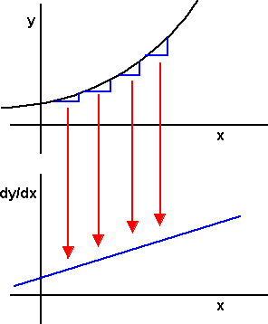

Differential calculus
The ratio of infinitesimal quantities
Instantaneous values
Rate of change
Tangent
Other examples

Slide 21
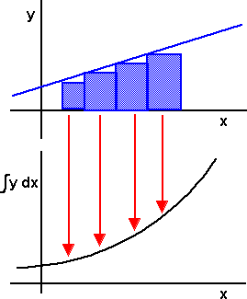

Integral calculus
Summing infinitesimal quantities
  Sum of all the little bits of ...
Area and volume
Other examples

Slide 22
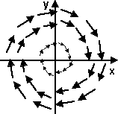
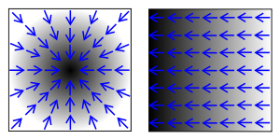
Calculus of vector fields (vector calculus)
Often found in nature: fluids, convection etc.
Every force is a field
Scalar fields and vector fields
Gradient
Divergence
Curl
Operator examples

Slide 23


Differential equations
Very common
  Motion
ODE vs PDE
Difficult to solve analytically
  Why even try?
Numeric solutions to ODEs
  Euler
  Midpoint
  Runge & Kutta

Slide 24
Thanks!
Hope you learned something kids ☺

